Slide 1

DEPARTMENT OF COMPUTER SCIENCE & ENGINEERING
SCHOOL OF COMPUTING
1156CS701- MAJOR PROJECT
IN-HOUSE
WINTER SEMESTER(2023-2024)
REVIEW - I
“Cyberattack Identification and Localization Using Adaptive Hierarchical Approach in Active Distribution Systems”
SUPERVISED BY
Dr .S.RAVIKUMAR.
Associate Professor.
PRESENTED BY
1. MOHAMMAD AFROZ (16850)(20UECS0616)
2. D M PHANI BHUSHAN (16937)(20UECS0218)
3. G C SASI KANTH (12412)(20UECS0281)

Slide 2
AGENDA
ABSTRACT
OBJECTIVE
INTRODUCTION
LITERATURE REVIEW
DESIGN AND METHODOLOGIES
IMPLEMENTATION
CONCLUSION
REFERENCES

Slide 3
ABSTRACT
Integration of advanced technologies into distribution systems increases vulnerability to cyber attacks.
Proposed adaptive hierarchical approach for cyber attack detection and localization aims to enhance resilience of active distribution systems.
Hierarchical structure allows efficient processing and analysis of diverse data sources like smart meters, sensors, and SCADA systems.
Machine learning algorithms enable continuous learning from historical data to improve detection capabilities and counter emerging threats.
System utilizes hierarchical layers to localize detected attacks, facilitating swift response and mitigation measures.
Effectiveness of approach validated through simulation studies on realistic distribution system models, demonstrating potential to bolster security against evolving cyber threats.

Slide 4
OBJECTIVES
Aim of the Project:
The aim of the project "Cyberattack Identification and Localization Using Adaptive Hierarchical Approach in Active Distribution Systems" is to develop advanced techniques and methodologies for identifying and mitigating cyber attacks in active distribution systems.
Develop algorithms and methods to detect cyber attacks targeting active distribution systems. This could involve anomaly detection, signature-based detection, or machine learning approaches to identify unusual patterns or behaviors indicative of an attack.
Design techniques to pinpoint the location of cyber attacks within the distribution system. This may involve analyzing network traffic, communication patterns, or system logs to determine the source and extent of the attack.

Slide 5
Scope of the Project:
The scope of the project "Adaptive Hierarchical Cyber Attack Detection and Localization in Active Distribution Systems" would likely involve several key components:
System Architecture Design: This would involve designing the overall architecture of the detection and localization system. It might include considerations such as distributed vs. centralized detection, integration with existing control systems, communication protocols, and hardware requirements.
Cyber Attack Detection Algorithms: Developing algorithms to detect cyber attacks on the distribution system. These could include anomaly detection techniques, machine learning algorithms, or signature-based detection methods.

Slide 6
INTRODUCTION
The rapid advancement of digital technologies has revolutionized power distribution systems, leading to the emergence of active distribution networks (ADNs) characterized by bidirectional power flows, distributed energy resources (DERs), and enhanced monitoring and control capabilities. While these advancements promise greater efficiency, reliability, and sustainability, they also introduce new challenges, particularly in cybersecurity.
Cyber attacks targeting power distribution systems pose significant threats to grid stability, operational integrity, and the safety of critical infrastructure. Traditional security measures, often focused on perimeter defense and intrusion detection, are inadequate to protect against sophisticated cyber threats that exploit vulnerabilities across interconnected devices and systems.

Slide 7
LITERATURE REVIEW
[1] F. Li, R. Xie, Z. Wang, L. Guo, J. Ye, P. Ma, and W. Song, “Online distributed iot security monitoring with multidimensional streaming big data,” IEEE Internet of Things Journal, 2021.
[2] F. Li, A. Shinde, Y. Shi, J. Ye, X.-Y. Li, and W.-Z. Song, “System statistics learning-based iot security: Feasibility and suitability,” IEEE Internet of Things Journal, 2020.
[3] F. Li, Q. Li, J. Zhang, J. Kou, J. Ye, W. Song, and H. A. Mantooth, “Detection and diagnosis of data integrity attacks in solar farms based on multilayer long short-term memory network,” IEEE Transactions on Power Electronics, vol. 36, no. 3, pp. 2495–2498, 2021.

Slide 8
LITERATURE REVIEW
[4] B. Wang, H. Wang, L. Zhang, D. Zhu, D. Lin, and S. Wan, “A data driven method to detect and localize the single-phase grounding fault in distribution network based on synchronized phasor measurement,” EURASIP Journal on Wireless Communications and Networking, vol. 2019, no. 1, p. 195, 2020.
[5] Y.-C. Chang and T.-C. Huang, “An interactive smart grid communication approach for big data traffic,” Computers & Electrical Engineering, vol. 67, pp. 170–181, 2019.
[6] J. Ye, L. Guo, B. Yang, F. Li, L. Du, L. Guan, and W. Song, “Cyber–physical security of powertrain systems in modern electric vehicles: Vulnerabilities, challenges, and future visions,” IEEE Journal of Emerging and Selected Topics in Power Electronics, 2021.

Slide 9
DESIGN AND METHODOLOGIES
Module 1: Hierarchical Cyber Attack Detection
Data Collection and Preprocessing:
Gather data from various sources within the active distribution system, including smart meters, sensors, SCADA systems, and communication networks.
Preprocess the data to remove noise, handle missing values, and normalize the features.
Feature Extraction:
Extract relevant features from the preprocessed data, such as power consumption patterns, voltage levels, frequency deviations, and network traffic characteristics.
Utilize advanced techniques like wavelet transforms or Fourier analysis to extract temporal and spectral features.
Anomaly Detection:
Implement machine learning algorithms, such as support vector machines (SVM), random forests, or deep learning models, to detect anomalies in the system behavior.
Train the models using historical data and validate their performance on unseen data to ensure robustness.

Slide 10
Module 2: Cyber Attack Localization
Attack Signature Analysis:
Analyze the detected anomalies to identify potential cyber attack signatures, such as characteristic patterns or signatures associated with specific attack types.
Use domain knowledge and expert systems to classify the detected anomalies into different attack categories.
Propagation Analysis:
Investigate the propagation behavior of cyber attacks within the distribution system, including the spread of malicious activities and their impact on network components.
Develop propagation models based on graph theory or network flow analysis to predict the spread of attacks in real-time.
Localization Algorithms:
Design localization algorithms to pinpoint the source and location of cyber attacks within the distribution network.

Slide 11
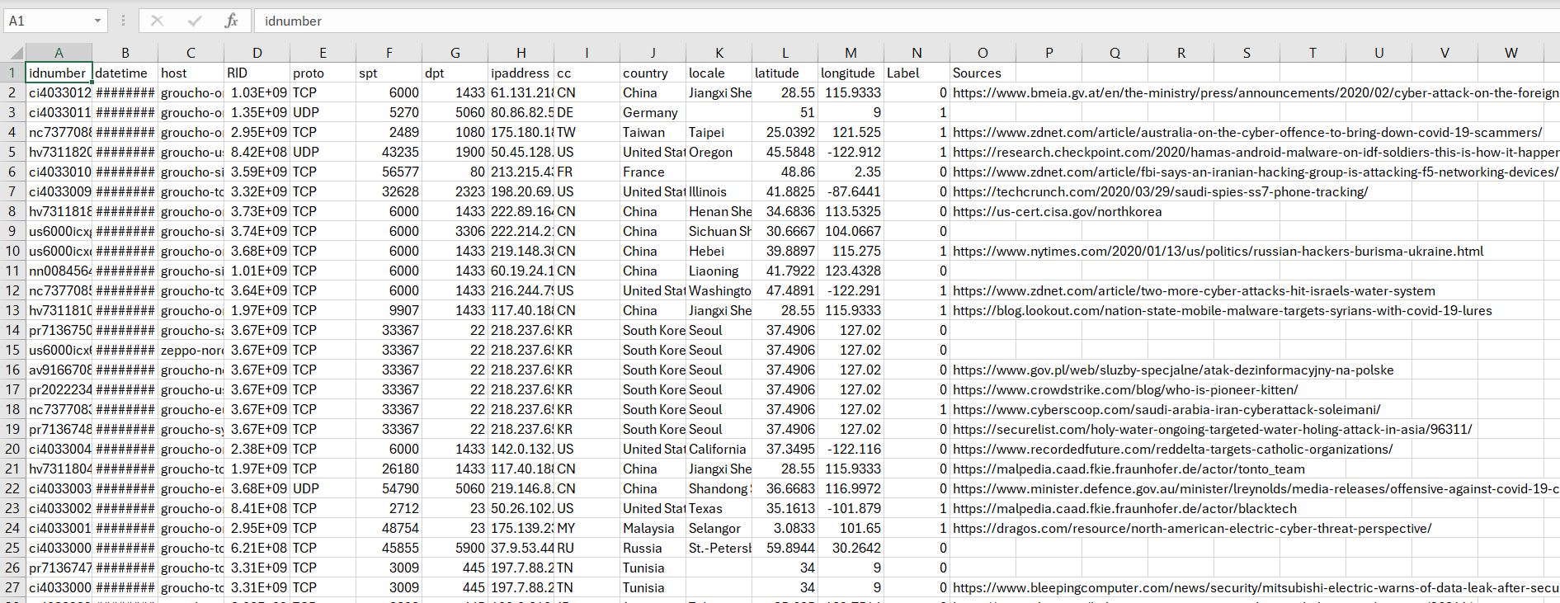
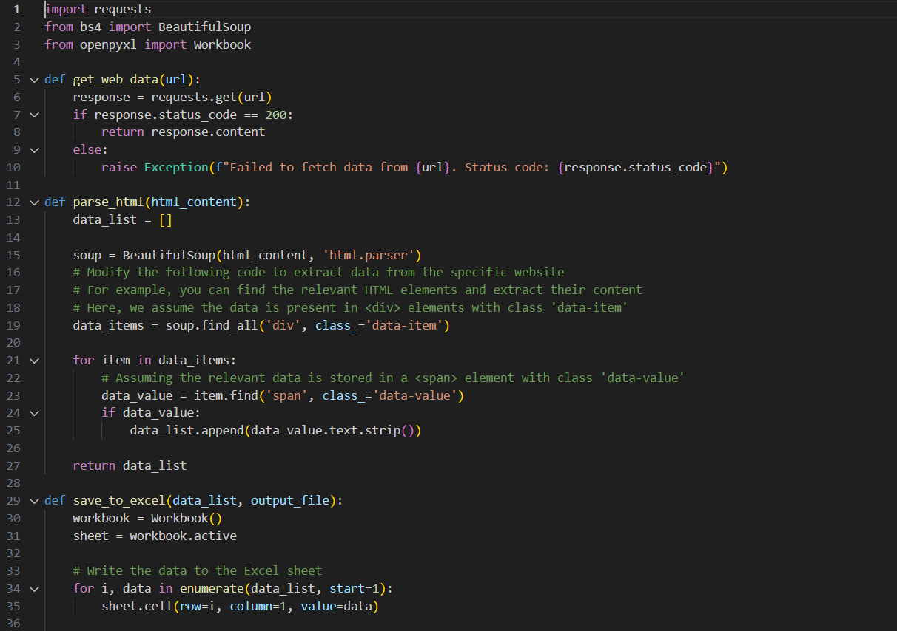
Step 2: Processing of data
Step 3: Apply Algorithms

Slide 12
IMPLEMENTATION
Architecture Diagram
Data –Flow Diagram
Use Case Diagram
Class Diagram
Activitiy Diagram
Sequence Diagram
Colloboration Diagram(If applicable)
E-R Diagram

Slide 13
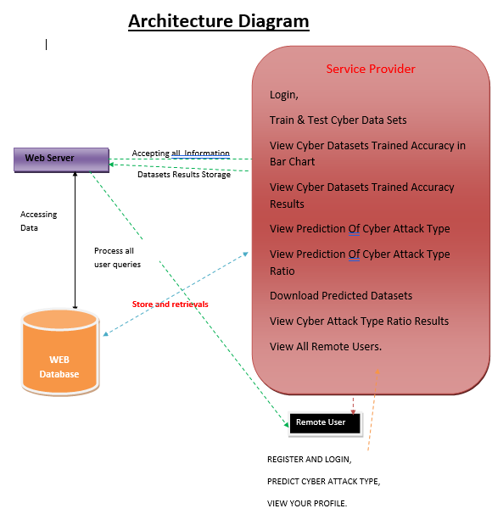
ARCHITECTURE DIAGRAM

Slide 14
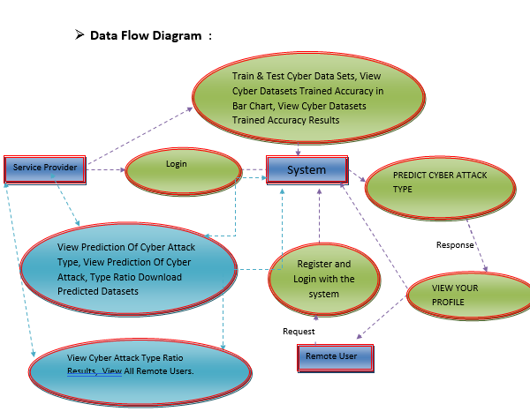
DATA FLOW DIAGRAM

Slide 15
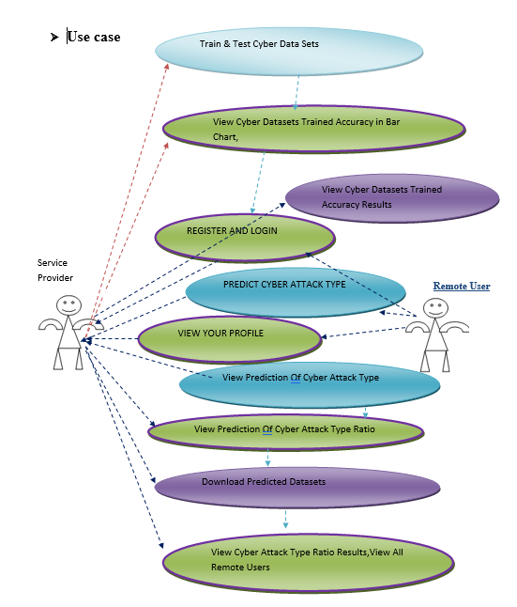
USE CASE DIAGRAM

Slide 16
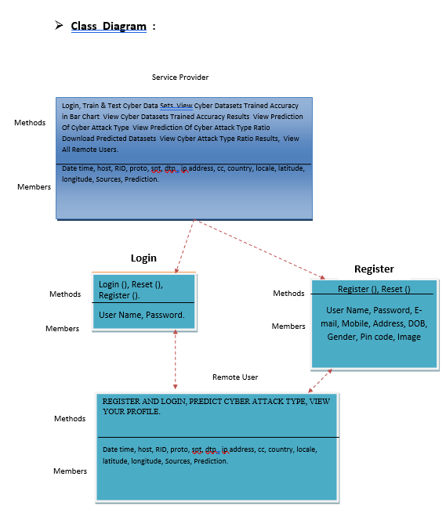
CLASS DIAGRAM

Slide 17
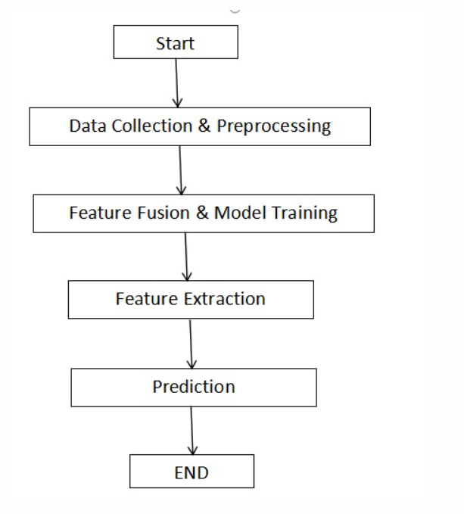
ACTIVITY DIAGRAM

Slide 18
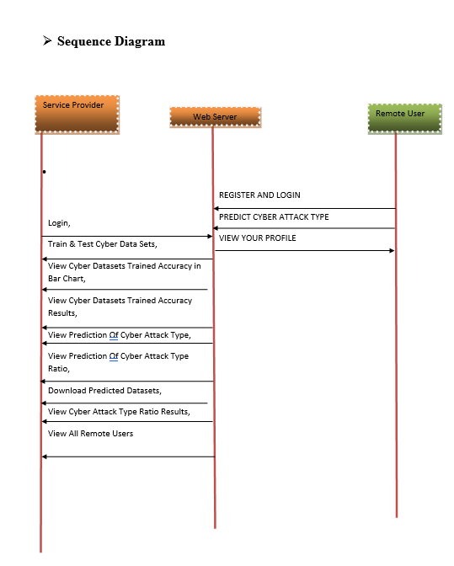
SEQUENCE DIAGRAM

Slide 19
REFERENCES
[1] I. Džafi´c, R. A. Jabr, S. Henselmeyer, and T. Ðonlagi´c, “Fault locationin distribution networks through graph marking,” IEEE Transactions onSmart Grid, vol. 9, no. 2, pp. 1345–1353, 2016.
[2] R. Bhargav, B. R. Bhalja, and C. P. Gupta, “Novel fault detection andlocalization algorithm for low voltage dc microgrid,” IEEE Transactionson Industrial Informatics, 2019.
[3] G. Wu, G. Wang, J. Sun, and J. Chen, “Optimal partial feedback attacksin cyber-physical power systems,” IEEE Transactions on AutomaticControl, vol. 65, no. 9, pp. 3919–3926, 2020.
[4] F. Li, Y. Shi, A. Shinde, J. Ye, and W.-Z. Song, “Enhanced cyberphysicalsecurity in internet of things through energy auditing,” IEEEInternet of Things Journal, vol. 6, no. 3, pp. 5224–5231, 2019.
[5] A. J. Wilson, D. R. Reising, R. W. Hay, R. C. Johnson, A. A. Karrar, and T. D. Loveless, “Automated identification of electrical disturbance waveforms within an operational smart power grid,” IEEE Transactions on Smart Grid, vol. 11, no. 5, pp. 4380–4389, 2020.

Slide 20
REFERENCES
[6] P. Dutta, A. Esmaeilian, and M. Kezunovic, “Transmission-line fault analysis using synchronized sampling,” IEEE transactions on power delivery, vol. 29, no. 2, pp. 942–950, 2014.
[7] I. Sadeghkhani, M. E. H. Golshan, A. Mehrizi-Sani, J. M. Guerrero, and A. Ketabi, “Transient monitoring function–based fault detection for inverter-interfaced microgrids,” IEEE Transactions on Smart Grid, vol. 9, no. 3, pp. 2097–2107, 2016.
[8] A. F. Bastos, S. Santoso, W. Freitas, and W. Xu, “Synchrowaveform measurement units and applications,” in 2019 IEEE Power & Energy Society General Meeting (PESGM). IEEE, 2019.
[9] Schweitzer Engineering Laboratories, Pullman, WA, USA., “SEL-T400L Time Domain Line Protection,” https://selinc.com/ products/T400L/, Last Access: July 31, 2020.
[10] Candura instruments, Oakville, ON, Canada., “iPSR intelligent Power System Recorder,” https://www.candura.com/ products/ipsr.html, Last Access: July 31, 2020.

Slide 21
THANK YOU

